Slide 1

Power/Performance analysis and optimization for deep learning on CPU-GPU platform
Ahmet Fatih Inci
Ting-Wu (Rudy) Chin
18-743 Energy-Aware Computing
Project Website: https://github.com/afinci/18-743-Power-and-Performance-optimizations-for-DNNs-on-CPU-GPU

Slide 2
Outline
Introduction
CPU Benchmarks and Results
GPU Benchmarks and Results
Future Work

Slide 3
Introduction
Profiling power/performance of embedded platform (TX1) while inferencing DNN on GPU and running benchmarks on CPU.
Nvidia Jetson TX1

Slide 4
CPU Benchmarks
bitcount (compute-intensive), jpeg (memory-intensive), string search (branch)

Slide 5
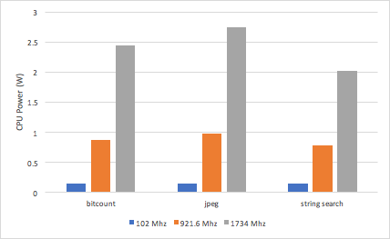
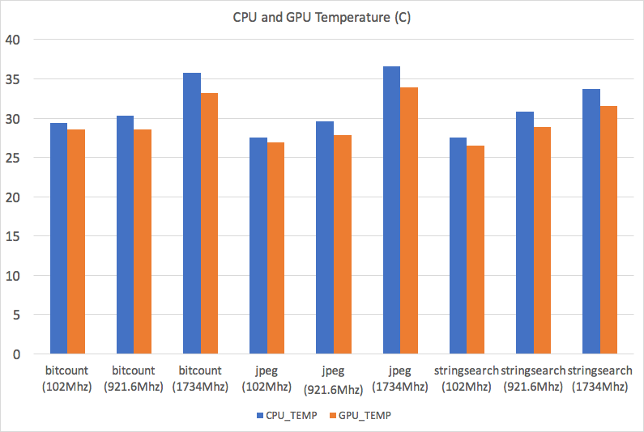
Results (CPU)

Slide 6
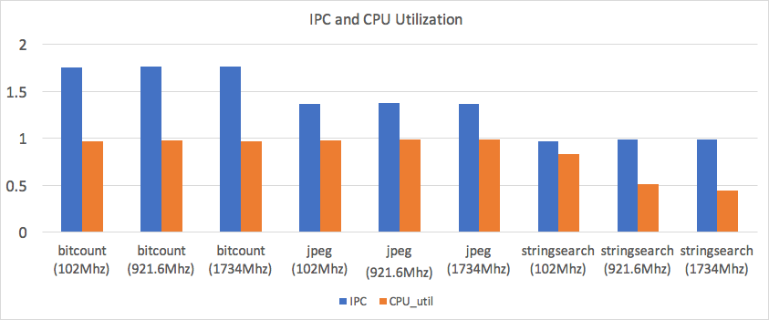
Results (CPU)

Slide 7
DNN Benchmarks
 | Memory Overhead | Number of Layers
AlexNet | 720 MB | 7
GoogLeNet | 820 MB | 22
ResNet-152 | 2224 MB | 152

Slide 8
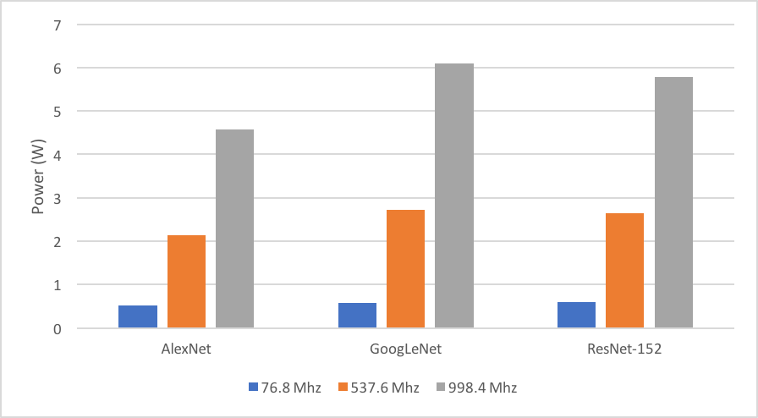
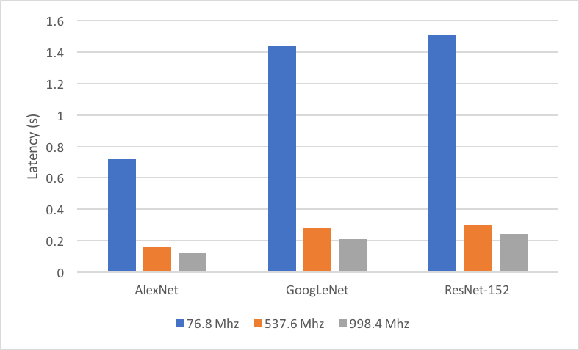
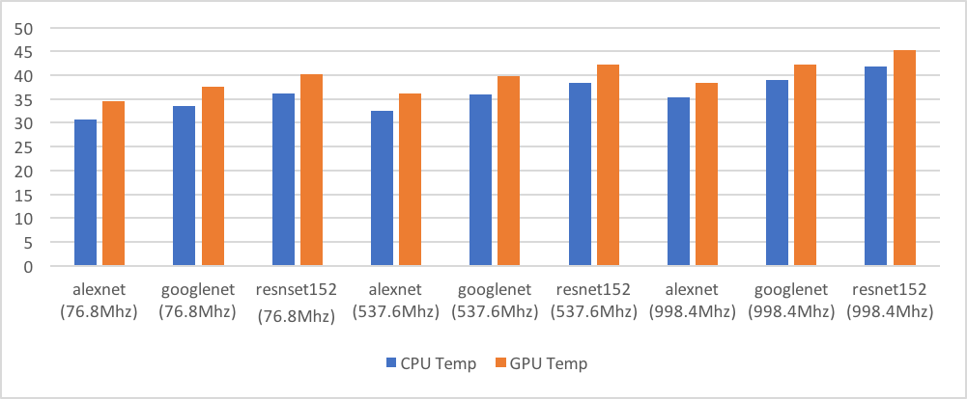
Results (GPU)

Slide 9
Future Work
M2
run CPU-GPU together by changing CPU-GPU frequency
analyze results

Slide 10
Q&A

